Slide 1


Science Writing
Writing Support Desk
writingsupport@uwindsor.ca

Slide 2

Purpose
There are, generally, two reasons to write a scientific paper:
To share your own original research
To review research conducted by others

Slide 3

In either case, your goal should be to inform, not to impress.
This workshop will discuss the essentials for structuring your scientific paper.
8

Slide 4
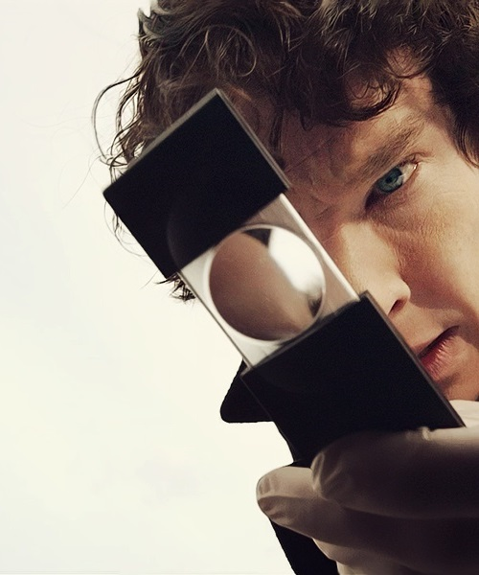
Writing in the Sciences: Tips of the trade
Use Jargon Sparingly!
Know Your Tenses: Past tense when referring to other authors, future tense for proposals
4

Slide 5

Writing in the Sciences: Tips of the trade (Continued)
Passive Voice vs. Active Voice
Drawing attention to the object of study, not the subjects. | Referring to other authors.
The subject(s) are not known. | Referring to a body of research.
Referring to an indeterminate group. | Referring to tables. graphs, or other sections of your own report.

Slide 6
Scientific Reports
(a.k.a. “lab reports” or “experimental reports”)
A piece of writing that seeks to describe the conditions that led to findings that contribute to our scientific knowledge.
Most reports will include the following sections:
Abstract
Introduction
Methodologies
Results
Discussion
Conclusion
Note: a scientific paper must do more than chronologically introduce your research. You should, at the same time, explain to your reader why your research findings are interesting, valid, acceptable, or important.

Slide 7
Abstracts are very short summaries of your work.
They are meant to draw in a potential reader so that they will engage with the full paper.
Abstract
Components of a good abstract include
Problem and Relevance. Here, you want to provide some background to the study, the motivation behind the study, and/or the specific question or hypothesis you addressed. You should be able to set the stage with only one or two sentences.
Methods. Next, you want to give a very brief overview of your methods.
Key findings. When describing your results, strive to focus on the main finding(s) and list no more than two or three points.
Conclusions based on findings and implications. The conclusions section is where you want to drive home the broader implications of your study.
* Remember that abstracts must be short. Be as concise as humanly possible.

Slide 8

Introduction
The purpose of your introduction is to discuss the motivation of your research and to prepare your reader for the structure of your paper.
There are four components that make up your introduction:
Context
Need (in context)
How does this work address the need
Preview the work to prepare your reader for the structure of your paper.
These sections (context and need) work together to express the motivation for the work presented in the paper.

Slide 9

Methods
This section of your report discusses how your experiment worked.

Slide 10

Methods
There are two basic questions that this section should address.
How was the data gathered?
How was the data analyzed?
Assume the reader understands the material.
(Minimal explanatory material.)

Slide 11

Results
4

Slide 12

Reporting the results.
Sections will vary depending on what you research.
Refers back to research questions or hypothesis.
Focus! Omit extraneous findings that do not relate to the overall theme.
6

Slide 13

Results (Continued)
Quantitative results tend to be more strait forward than qualitative, like you might find in the social sciences.
Often tables and figures can be used to keep this section succinct.

Slide 14
Results (Continued)
Structure the results section either
In order of statistical complexity, easier to harder…
…or in order of research question.
4

Slide 15
Results (Continued)
Present data and all statistical notations consistently.
You are generating the impression that care and precision went into your work.
Clean and crisp results show professionalism.

Slide 16

Tables & Figures
Keep tables and figures strait forward yet attractive!
Used to limit continuous lines of data in the text of your document.
How they are set out varies by reference method.
Journals usually request them at the end of the document, not within.
6

Slide 17

Tables & Figures (continued)
Don’t over clutter, simplicity is key!
There is such a thing as too much with tables & figures.
Use these as needed, but don’t over saturate with information.
6

Slide 18


Tables & Figures (continued)
Be sure to pick the best way to represent your data!
Use a table if the values are important.
Use a figure if you are making a comparison.
Label your axes appropriately, including unit of measure.
4

Slide 19

Tables & Figures (continued)
Do not present data in multiple formats (avoid redundancy)
Present in text, table or figure, but do not use multiple formats to present the same data.
However, you can use a mix of tables an figures, just not for the same data.
6

Slide 20

Tables & Figures (continued)
Researchers are busy and may only read your abstract and figures, without reading your paper. Make sure that your tables and figures…
“stand alone”
The table or figure should tell the whole story.
This is why it is important to offer descriptive captions or legends, defining abbreviations.
6

Slide 21

Discussion
Begin this section with a very brief overview of the research to remind the reader the purpose of the research.
Add a sentence or two to highlight the major outcomes.
This is the discursive and thus, the most quotable part of your paper.
This section positions the research within the field, confirming or rejecting what has been found before.
6

Slide 22

Discussion (continued)
Do not speculate too much!
While it is tempting to make big claims, it is important to stay within the limits of what can be supported by your research or research that could be done in future studies.
It is best to discuss your results in the order your research questions were addressed. Consistency is the key.
6

Slide 23

Discussion (continued)
Every study has its limits!
It is important to address any limitations of your research.
Don’t be too critical of your research.
The point is to account for the main issues with your research and discuss how you have attempted to manage the impact of these issues on your data.
This is also an opportunity to discuss future research…
6

Slide 24

Conclusion
Keep it brief!
This section has three main goals to accomplish:
This section summarizes what was found and what it means.
The conclusion points to future research or potential applications.
Leaves your reader with food for thought.
6

Slide 25


